Slide 1
Warby Parker
Charles Klecka July 5, 2018

Slide 2
Table of Contents
1. Get Familiar with Warby Parker 2. Quiz Funnel 3.A/B Testing with Home Try-on Funnel

Slide 3
Warby Parker
Is a transformative lifestyle brand Founded 2010 Warby Parker believes in creative thinking, smart design and doing good in the world.

Slide 4
Style Quiz
Survey table has the following Columns Question User_id Response
Notes:
SELECT *
FROM Survey
Limit 10;

Slide 5
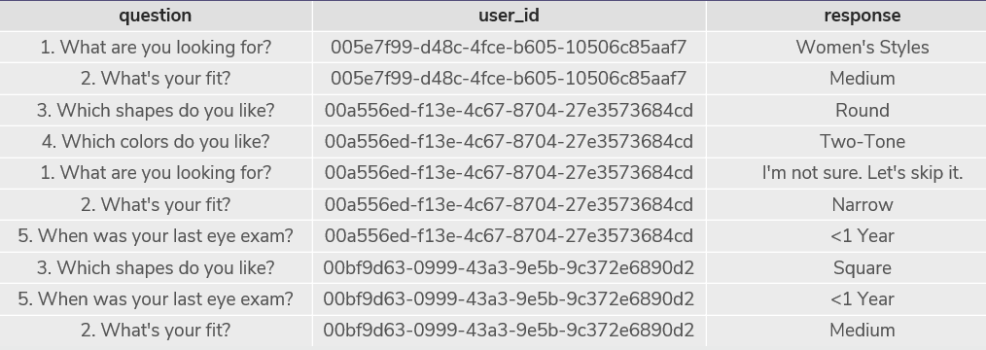

Slide 6
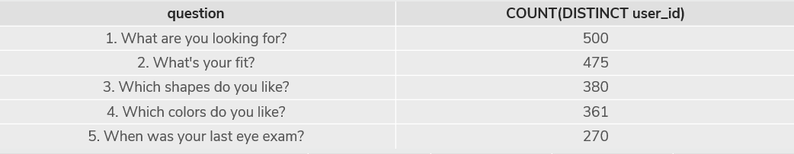
Responses of each question.
Notes:
SELECT question,
COUNT(DISTINCT user_id)
FROM survey
GROUP BY question; Excel Percentage formula: =500/500*100 500 100% 475 95% 380 76% 361 72% 270 54% Which question(s) of the quiz have a lower completion rates? Which colors do you like? And When was your last eye exam? What do you think the reason? Well, people get tired answering survey questions. I don’t think colors plays a huge role in picking glasses. Eye exam questions I just don’t see the relevance of the question. I figure people answering the survey might had the same though.

Slide 7
Home Try-On Funnel
Quiz Columns user_id style fit shape color
Notes:
SELECT * FROM quiz Limit 5;

Slide 8
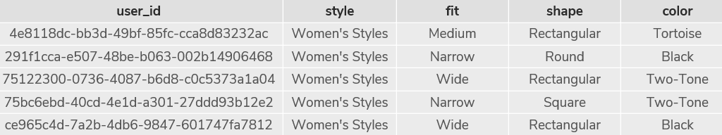

Slide 9
Home_try_on user_id number_of pairs address
Notes:
SELECT * FROM home_try_on LIMIT 5;

Slide 10
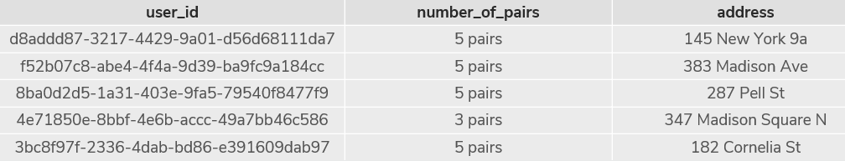

Slide 11
Purchase columns: user_id product_id style model_name
Notes:
SELECT * FROM purchases LIMIT 5;

Slide 12
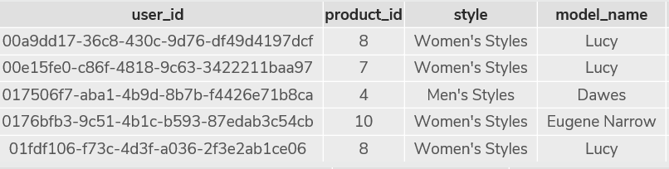

Slide 13
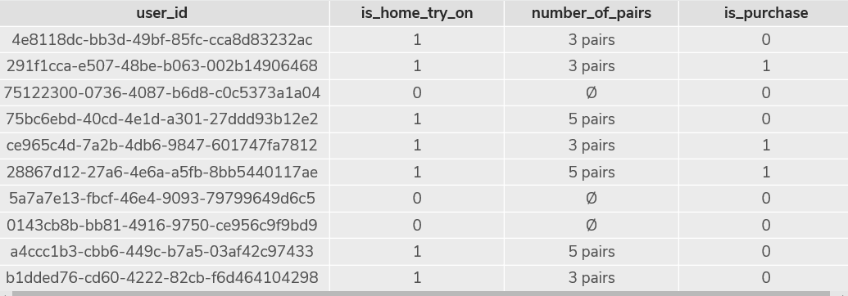
Left Join
Notes:
SELECT DISTINCT q.user_id, h.user_id IS NOT NULL AS 'is_home_try_on', h.number_of_pairs, p.user_id IS NOT NULL AS 'is_purchase’ FROM quiz q LEFT JOIN home_try_on h ON q.user_id = h.user_id LEFT JOIN purchase p ON p.user_id = q.user_id LIMIT 10; What are some actionable insights for Warby Parker?

